Slide 1

Monthly Market Mantra
May, 2026
SEBI Registered: SHRIRAMMF | Registration no: MF/017/94/4
Monthly Market Update April 2026

Slide 2
Market Overview
India
India CPI edged up to ~3.4% in Mar-26, core inflation remains sticky
GDP growth projected at ~6.9% for FY27, easing from 7.6% in FY26
India’s goods trade deficit narrowed to $20.1 bn in Mar-26, driven by lower gold and oil imports
Other International Market
Bank of England holds rates, flags inflation risks from Iran war
Japan’s 1O-Year bond yield hit 2.48% in Apr-26, reflecting inflation & market volatility
South Korea GDP up 3.6% YoY, led by strong semiconductor exports
U.S.
US CPI rose to ~3.3% in Mar-26, led by higher energy prices amid the Iran conflict
US Fed held interest rates in Apr-26, higher for longer stance persists
US 10-year Treasury note rose to around 4.4% in Apr-26, driven by sticky inflation and policy Uncertainty
International
Brent crude oil >$100/bbl, driven by tight supply and risks of disruption in the Strait of Hormuz, a key global transit route
Gold trading near ~ $4,665 / oz amid Middle east tensions
Global outlook cautious amid West Asia tensions, keeping energy markets and financial conditions volatile
Source: Moneycontrol, Bloomberg, CNBC, Trading economics
As on 5thMay 2026
www.shriramamc.in

Slide 3
Indian markets rebounded in Apr-26
Broad-based gains were observed across all indices in 1M period
Disclaimer: Past performance may or may not sustain in the future
Data Source: NiftyIndices.com
Data as on 30th April, 2026
www.shriramamc.in

Slide 4
Global Markets (MSCI) – Geopolitical Impact
Global markets rebounded in Apr-26 from March lows, supported by recovery in risk sentiment amid ceasefire hopes
Supply-side disruptions and energy price volatility remain key concerns amid broader global uncertainty
MSCI World Index
Data Source: MSCI.com
Data as on 30st April 2026
Disclaimer: Past performance may or may not sustain in the future
www.shriramamc.in

Slide 5
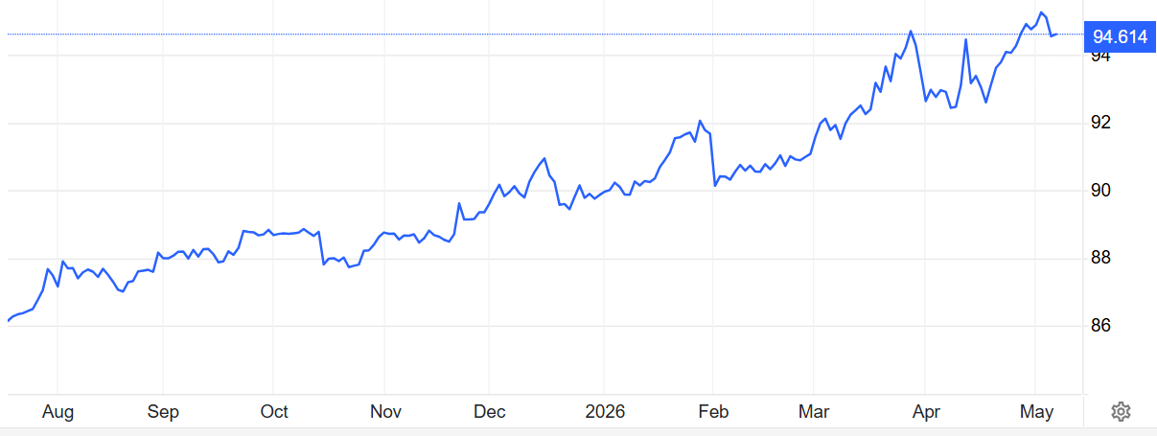
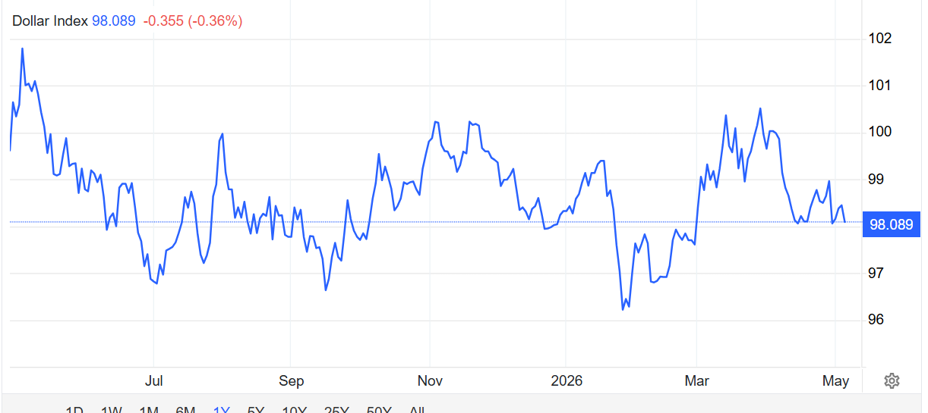
INR weakness driven by stronger DXY
USD/INR price 1 YR data
DXY Index 1Y data
INR just below 95 mark, pressured by high oil prices, FII outflows, and a strong dollar
DXY strengthened post West Asia conflict, reflecting safe heaven demand and a firmer dollar
Source: Trading economics
INR & DXY Index data as on 6th May,2026
www.shriramamc.in

Slide 6
FIIs remained net sellers in Apr-26
DIIs buying moderated sharply in Apr-26
Source: Moneycontrol.com
FII data as on 30th Apr-26 &DII data as on 28th Apr-26
www.shriramamc.in

Slide 7
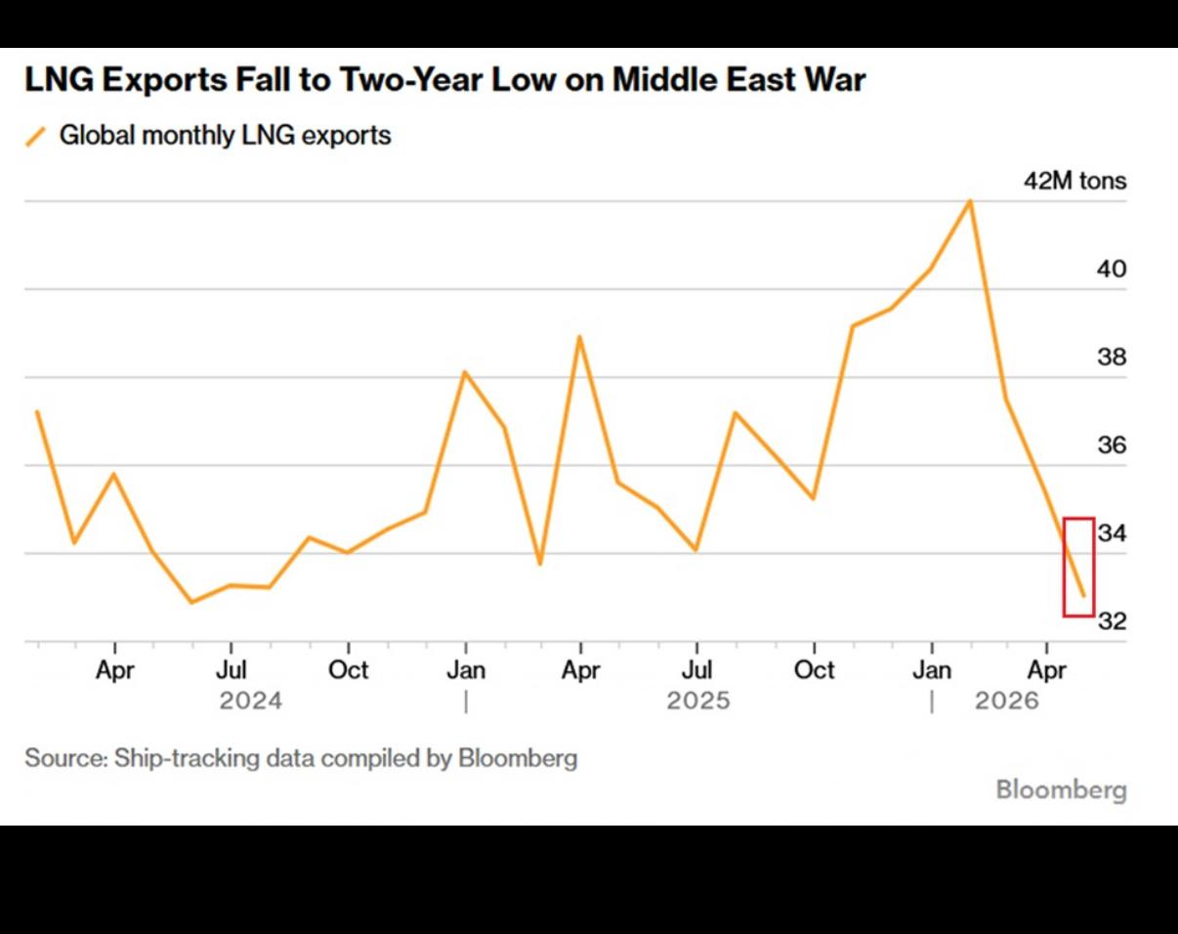
Global LNG supply disruption
Global LNG exports fell ~7% MoM to ~33 mn tons in Apr-26, lowest since May-24, amid Qatar disruption and Strait of Hormuz closure
Source: The Kobessi Letter
www.shriramamc.in

Slide 8
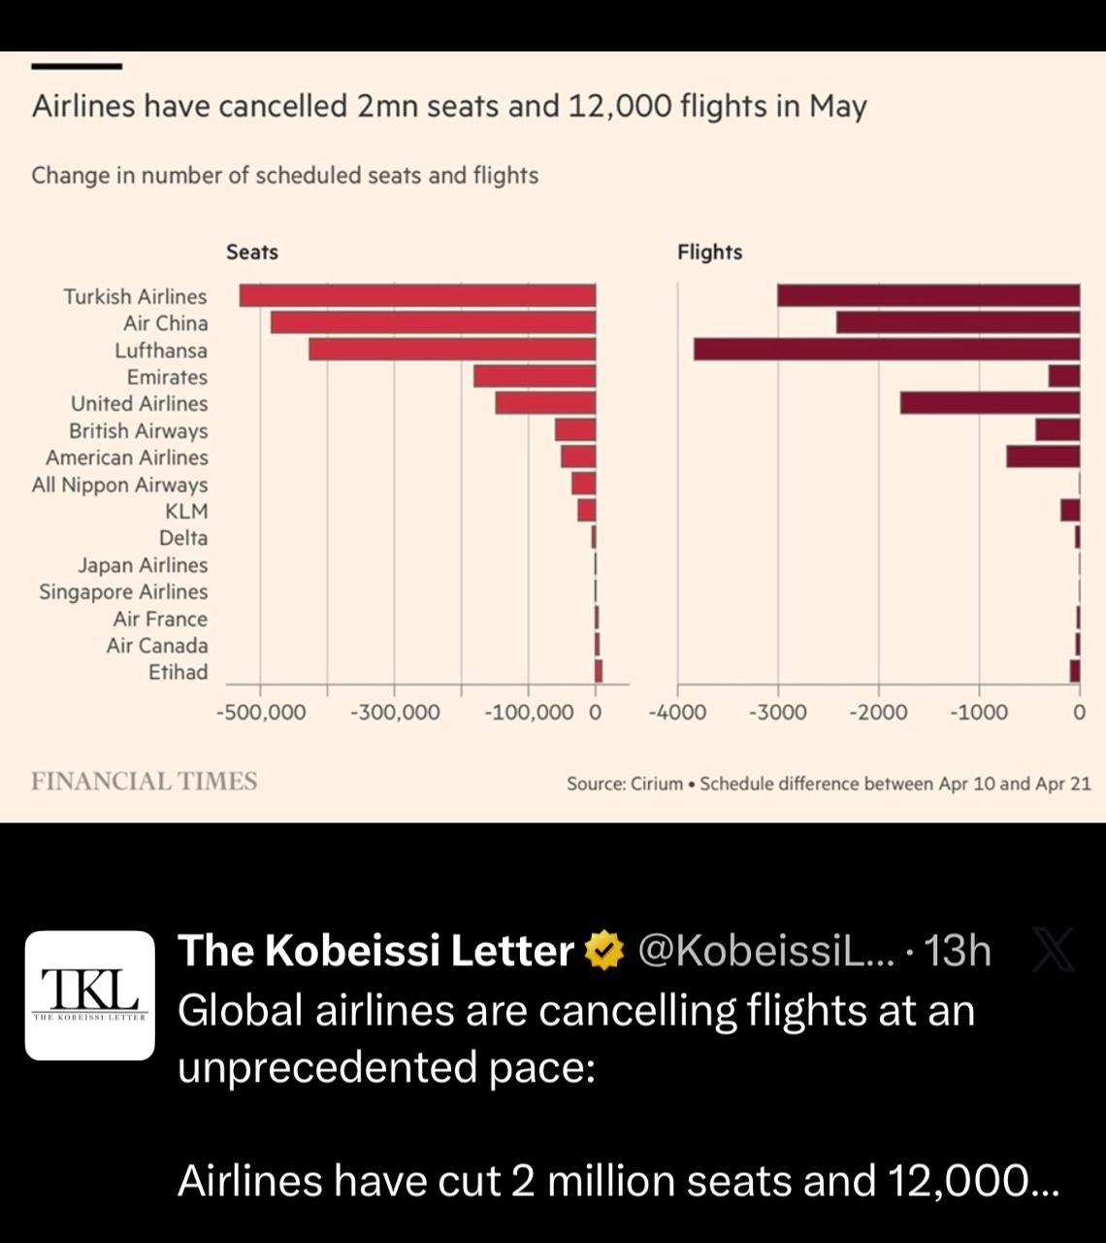
Global airlines cuts on cost surge
Global airlines cut ~2mn seats and 12,000 flights in May schedule amid unprecedented cancellations, driven by soaring jet fuel costs and supply disruptions
Source: The Kobessi Letter
www.shriramamc.in

Slide 9
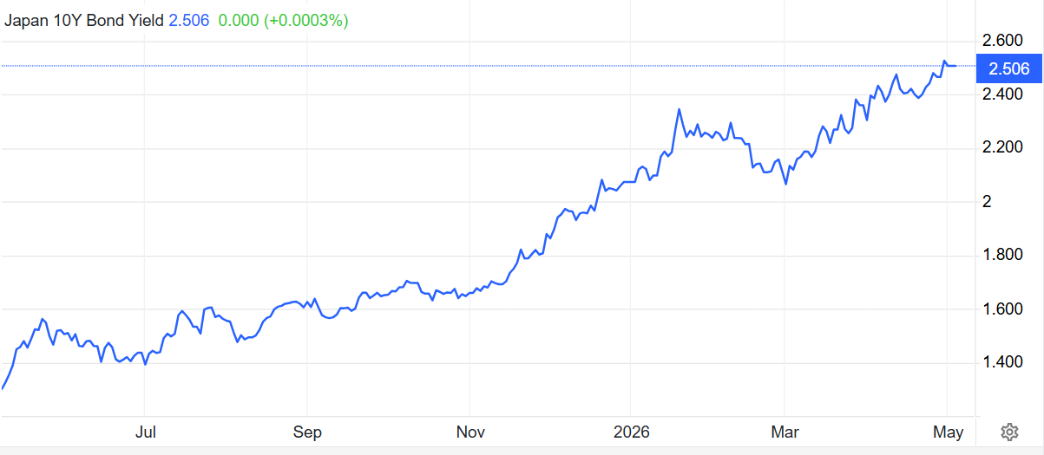
Japan’s bond yields signal policy shift
1YR data
Japan 10Y yield at peak reflects policy normalization and rising inflation expectations, with potential global spillovers
Source: Trading economics, data as on 5th May,2026
www.shriramamc.in

Slide 10
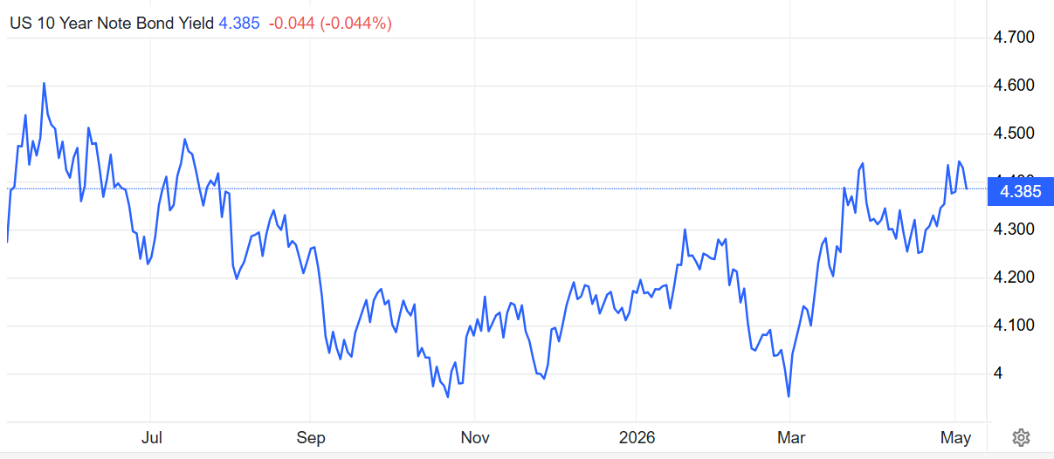
US 10Y Yields Signal Tight Liquidity
1YR data
US 10Y at ~4.4% signals tighter conditions, higher for longer rates, and pressure on global borrowing and risk assets
Source: Trading economics, data as on 5th May-26
www.shriramamc.in

Slide 11
Sector Indices performance – Apr-26
Period | Nifty Auto | Nifty Bank | Nifty Consumer Durables | Nifty CPSE | Nifty FMCG | Nifty Pharma | Nifty IT | Nifty Metal | Nifty Oil & Gas | Nifty Realty | Nifty Energy | Nifty Commodities
1M | 9% | 6% | 13% | 8% | 12% | 5% | 1% | 15% | 8% | 22% | 17% | 12%
3M | -3% | -8% | 8% | 9% | 0% | 7% | -23% | 9% | -1% | 1% | 16% | 6%
6M | -3% | -4% | -3% | 13% | -9% | 5% | -18% | 21% | -2% | -16% | 12% | 9%
1Y | 16% | 1% | 0% | 19% | -10% | 7% | -18% | 50% | 5% | -10% | 19% | 20%
IT and Pharma were largely flat over the 1M period, while other sectors posted higher gains
Data Source: NiftyIndices.com
Data as on 30th April,2026
Disclaimer: Past performance may or may not sustain in the future
www.shriramamc.in

Slide 12
Sectors update
Sectors | Key Developments | Valuation | Our View
Consumer Durables | RAC demand remains strong on heatwave led sales, though supply constraints persist, especially in premium models. Broader consumer durables, including electricals and cables and wires, show mixed trends, with cables and wires seeing near term demand softness despite cost led price support | Trailing P/BV at 5 yr average | Underweight
Oil & Gas | Crude stayed >$100/bbl in Apr-26 amid Strait of Hormuz disruptions and West Asia tensions, keeping markets tight; India’s import bill remained high despite lower volumes, with limited fuel price pass through and fiscal measures cushioning impact | Trailing P/BV at 5-yr average | Stock Specific
Auto | Apr-26 saw broad YoY growth in 2Ws, PVs and 3Ws, though MoM softened on seasonality and high March base; PVs led by SUVs, 2Ws by rural recovery and EV demand, 3Ws resilient, while CVs and tractors remained weak, with Q1FY27 risks from supply disruptions, high costs and West Asia tensions. | Trailing P/BV trading above 5-yr average | Stock specific
FMCG | West Asia tensions are likely to impact FMCG through higher crude-linked input costs (petroleum derivatives), along with pressures on packaging, freight and palm oil, making crude volatility a key margin risk for Q1 FY27 (with limited Q4 impact due to inventory buffers). Unseasonal rains across North and East India in March’26 have also dampened demand for summer categories | Trailing P/BV just above -1 SD | Stock specific
Disclaimer: Sectors specific views mentioned herein are for Information purpose only, the Fund may or may not hold any present or future positions in these sectors
www.shriramamc.in

Slide 13
Sectors update
Sectors | Key Developments | Valuation | Our View
Banks | India’s banking sector remains strong, with credit growth at 14.9% YoY (Apr 15, 2026), seasonal sequential dip, supported by retail and corporate demand and 12.1% deposit growth; Q4FY26 trends healthy, with ECL norms from Apr 2027 manageable via glide path, while near term risks persist but outlook stays positive. | Trailing P/BV near –1 SD | Stock Specific
Metals | Domestic steel prices remain firm, driven by supply disruptions, high freight and rising raw material costs, with further hikes indicated; iron ore and non coking coal firmed while coking coal softened, exports rose and imports declined, though the rally is cost driven and may weigh on demand, while aluminium outperforms and other non ferrous see mild corrections. | Trailing P/BV >+2× SD | Stock specific
CPSE | India’s defence exports surged 63% YoY to ₹38,424 cr, reflecting a shift toward a self reliant, export oriented ecosystem, supported by policy push, higher spending and rising private participation alongside DPSUs, improving competitiveness and innovation. Power demand and generation remain strong with record peak demand ~256 GW (Apr-26), driven by heatwaves and rising output, alongside increasing renewable share and continued energy transition. | Trailing P/BV ~ near +1× SD | Stock specific
Disclaimer: Sectors specific views mentioned herein are for Information purpose only, the Fund may or may not hold any present or future positions in these sectors
www.shriramamc.in

Slide 14
Sectors update
Sectors | Key Developments | ValuationFY25 | Our View
IT | Indian IT sees steady AI-led progress, though near term demand remains cautious with delayed discretionary spends and slower deal conversions; large caps focus on efficiency amid muted growth visibility, while Tier 2 firms benefit from operating leverage and pricing, with INR depreciation offering partial margin support | Trailing P/BV at -2 SD | Stock Specific
Pharma | Pharma growth remains supported by stable domestic portfolios, price hikes and launches; US business may see near term drag from high Revlimid base, with currency aiding margins partly offset by higher freight and API costs. Pipeline strength, including semaglutide, and strategic expansion support outlook, while diagnostics sees strong Q4 growth and margins, with reagent cost inflation a key risk | Trailing P/BV near +1 SD | Stock specific
Chemicals | Iran war and El Niño risks are driving sharp input cost inflation, with fertilizer prices surging, while supply disruptions offer short term support; however, weak demand, destocking and rising prices may weigh on consumption, with mixed chemical trends as agrochemicals rise and base chemicals correct amid global supply tightness. | Trailing P/BV fairly valued | Stock specific
Disclaimer: Sectors specific views mentioned herein are for Information purpose only, the Fund may or may not hold any present or future positions in these sectors
www.shriramamc.in

Slide 15
Global Update
www.shriramamc.in

Slide 16
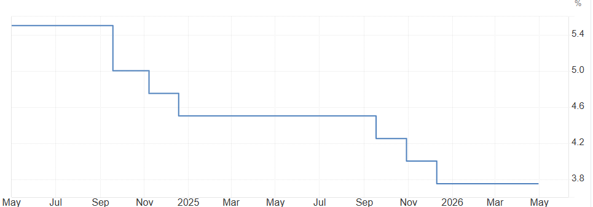
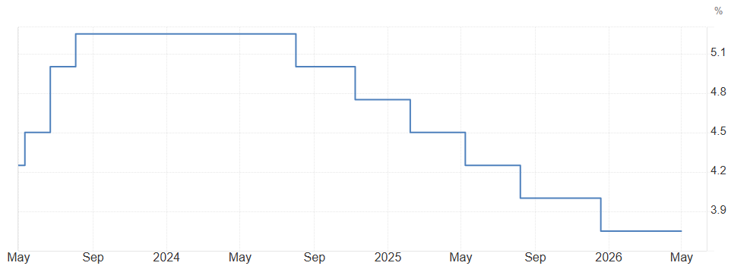
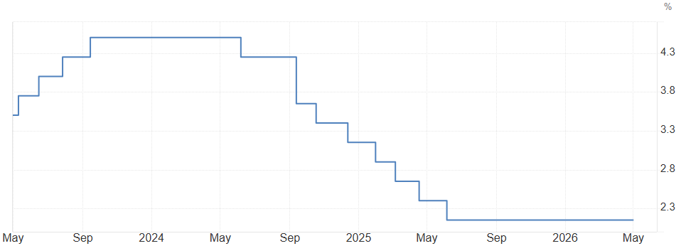
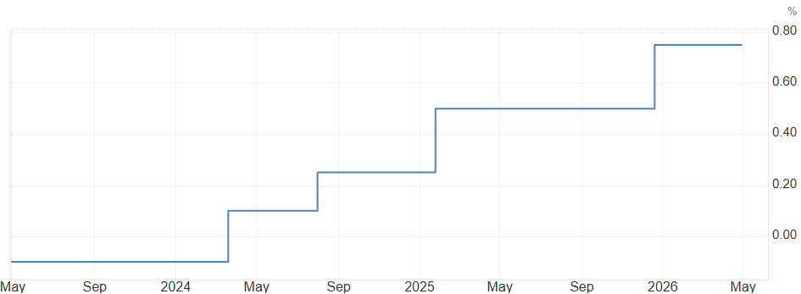
Global rates steady amid cautious policy stance
U.S. (unchanged in Apr-26)
UK (unchanged in Apr-26)
EU (unchanged in Apr-26)
Japan (unchanged in Apr-26)
Source: Trading Economics
www.shriramamc.in

Slide 17
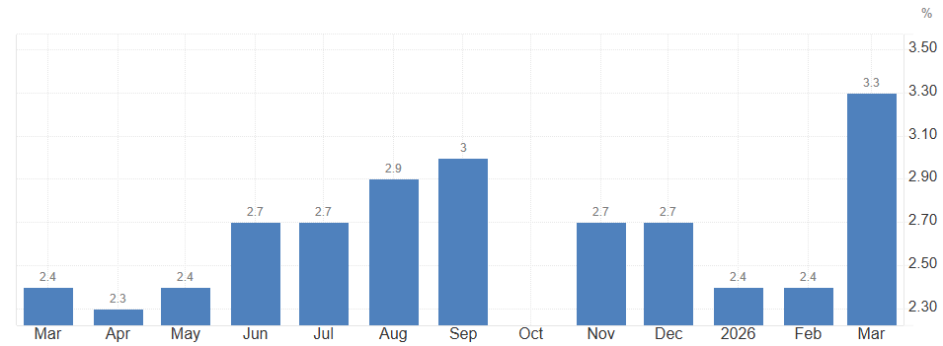
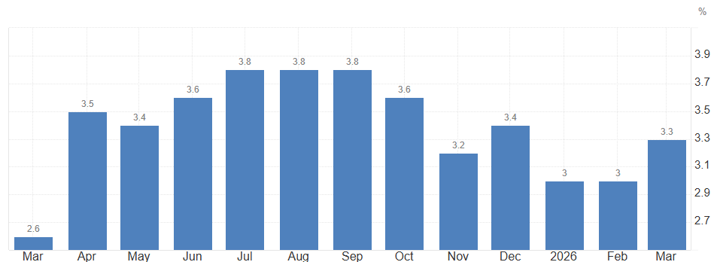
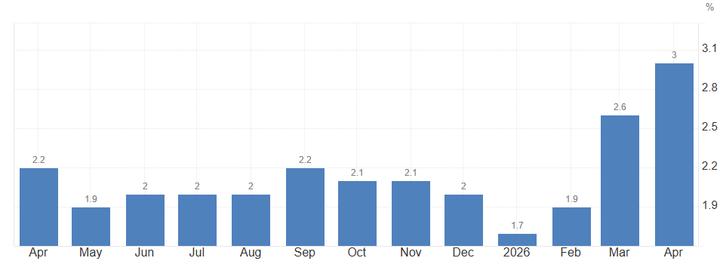
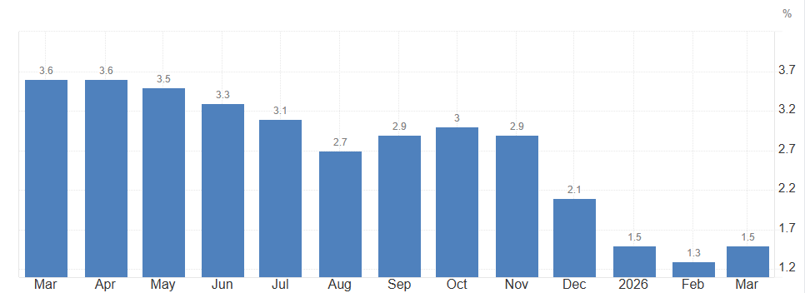
Global inflation rising
U.S
UK
EU
Japan
Source: Trading Economics
www.shriramamc.in

Slide 18
Domestic Update
www.shriramamc.in

Slide 19
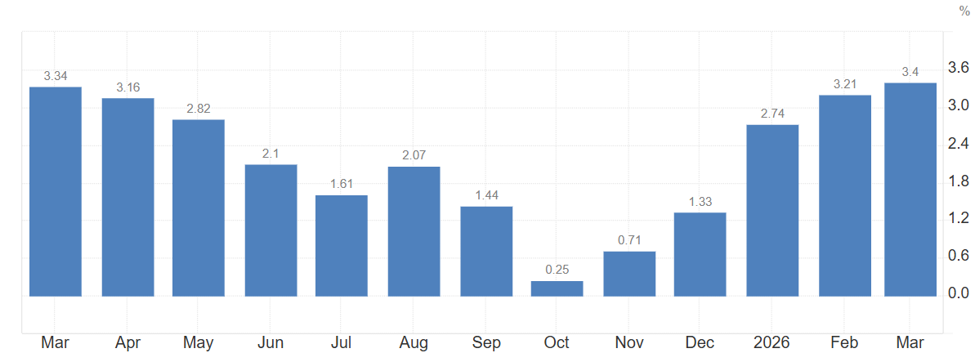
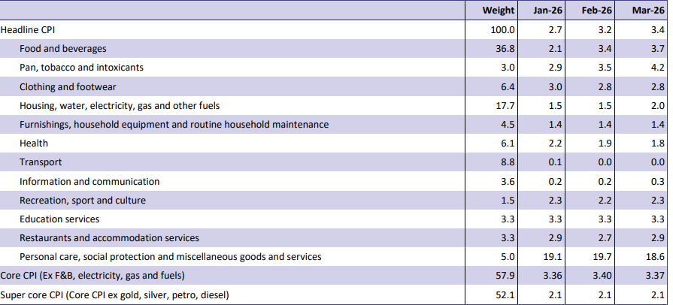
Macro updates
Inflation rate M-o-M
CPI by Component
CPI rose to 3.4% YoY in Mar-26 (from 3.2%), with higher food and gas inflation
Geopolitical impact muted, but oil and monsoon risks may push inflation higher, likely within RBI’s 2–6% band
Source: Nuvama research , Trading economics CPI data as on Mar-26
www.shriramamc.in

Slide 20
Robust GST collections in Apr-26
GST collections up 8.7% YoY to ~Rs 2.43 lakh crs in Apr-26, driven by strong consumption
Source: Gst.gov.in
www.shriramamc.in

Slide 21
PMI : Manufacturing Strengthens
India’s Manufacturing PMI rose to 55.9 in Apr-26, signaling sustained expansion
India’s Services PMI remained steady at 57.9 in Apr-26, driven by rising demand
Source: Trading Economics
Data as on Apr-26
www.shriramamc.in

Slide 22
Outlook – Medium Term
Liquidity
RBI absorbed ₹2tn via 7-day VRRR (10th April,2026), tightening liquidity and pushing bond yields higher
Interest rate
RBI keeps interest rates unchanged in Apr-26, maintains neutral stance
Bond Markets
Equity Markets
India’s 10Y G-sec rose to ~7% in Apr-26, geopolitics lifted oil, pressuring inflation and rupee
Indian markets remain volatile, weighed by rising crude oil prices, FII outflows, and geopolitical tensions in West Asia
Fed left interest rate unchanged in Apr-26, amid geopolitical risk
US 10Y note yield rose to ~4.4% in Apr-26, middle East tensions fuel inflation fears
Global markets in turmoil amid crude spike, geopolitics, inflation fears
INR remained under pressure, with RBI managing liquidity to ensure market stability
Inflation
India’s CPI rose to 3.4% in Mar-26, while core inflation stayed firm, reflecting sustained underlying price pressures
US headline CPI jumped to 3.3% (Mar-26), led by high energy costs amid the war with Iran
Source: Trading Economics, Investing.com, Money control, Federal reserve
www.shriramamc.in

Slide 23
Key Risks
Middle East tensions likely to keep oil prices elevated and inflation sticky
Supply chain risks may emerge from Q1FY27 amid global disruptions
India’s valuations remain elevated, limiting near-term upside versus other emerging markets
Strong US dollar may pressure the rupee and sustain capital outflows
Potential El Niño impact could disrupt monsoons and weigh on rural demand and inflation
www.shriramamc.in

Slide 24
Disclaimer
DISCLAIMER The views expressed herein are based on internal data, publicly available information and other sources believed to be reliable. Any calculations made are approximations, meant as guidelines only, which you must confirm before relying on them. This document has been prepared based on information, which is already available in publicly accessible media or developed through analysis of Shriram Mutual Fund. The recipient should note and understand that the information provided above may not contain all the material aspects relevant for making an investment decision and the security may or may not continue to form part of the scheme's portfolio in the future. Investors are advised to consult their investment advisor before making any investment decision in light of their risk appetite, investment goals, and horizon. The decision of the Investment Manager may not always be profitable; as such decisions are based on the prevailing market conditions and the understanding of the Investment Manager. Actual market movements may vary from the anticipated trends. Past performance may or may not be sustained in future. Sectors referred above are illustrative and not recommended by Shriram Mutual Fund (the Fund) / Shriram AMC. The Fund may or may not have any present or future positions in these sectors. Shriram AMC / the Fund is not guaranteeing / offering / communicating any indicative yield on investments made in the scheme(s). Neither Shriram AMC and the Fund nor any person connected with them, accepts any liability arising from the use of this document. The recipient(s) before acting on any information herein should make his/her/their own investigation and seek appropriate professional advice and shall alone be fully responsible / liable for any decision taken on the basis of information contained herein. Please refer to the Offer Documents/ Statement of Additional Information/ Key Information Memorandum of the Scheme before investing.
MUTUAL FUND INVESTMENTS ARE SUBJECT TO MARKET RISKS, READ ALL SCHEME RELATED DOCUMENTS CAREFULLY.
www.shriramamc.in

Slide 25
Thank You

